Slide 1
Hello
Unit 1
Lesson 1
Teacher: Nguyen Thi Thuy Ha

Slide 2
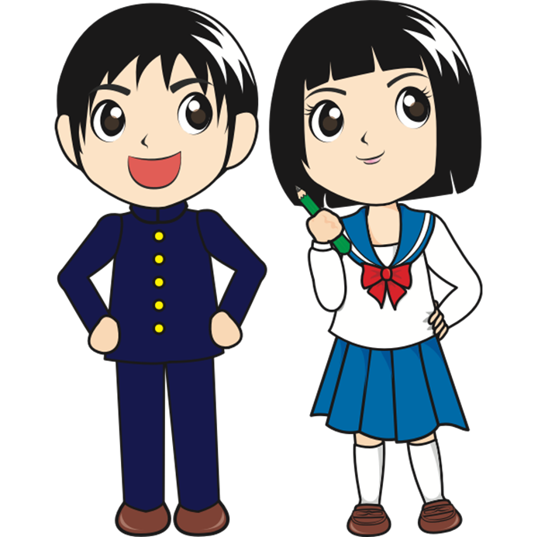
Hi
Hello
/haɪ/
/həˈləʊ/

Slide 3
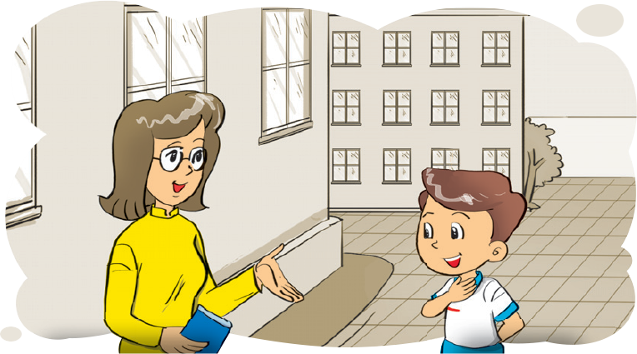
Miss
/mɪs/

Slide 4
Nice to meet you
/naɪs tuː miːt ju/

Slide 5
LET’S WATCH

Slide 6
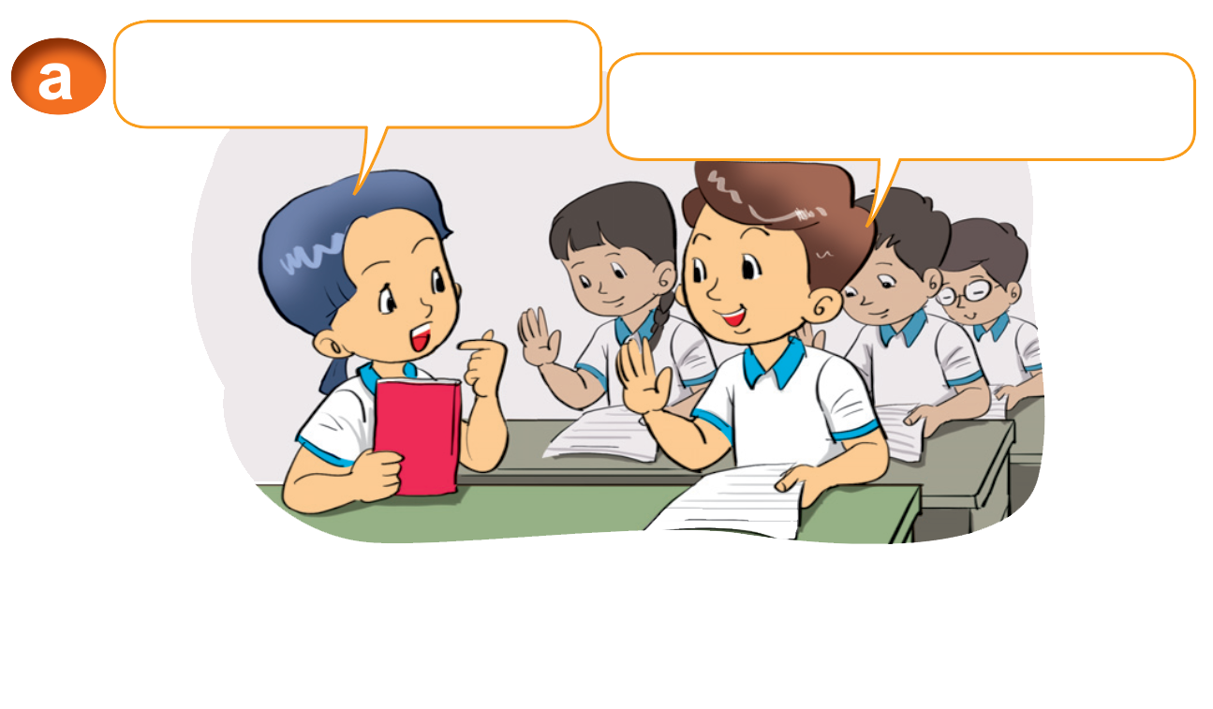
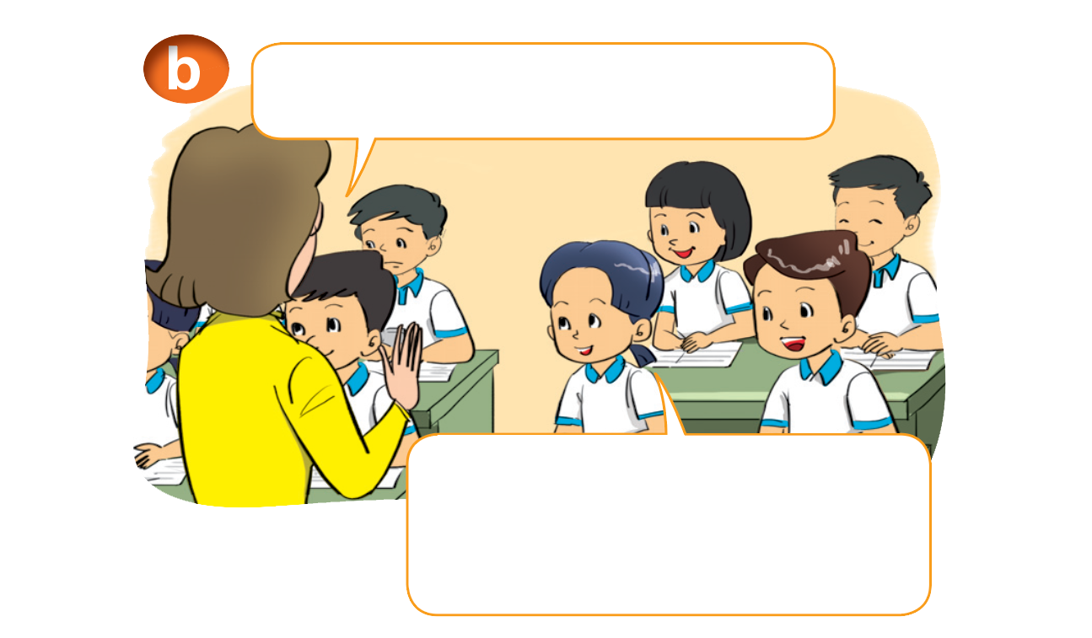
1. Look, listen and reapeat
Hello. I'm Mai.
Hi, Mai. I'm Nam.
Hello. I'm Miss Hien.
Hello, Miss Hien. Nice to meet you.

Slide 7
Introduce your name:
I am + name
I am = I’m

Slide 8
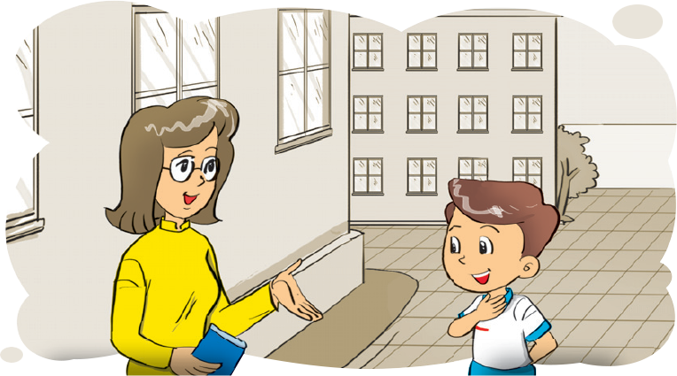
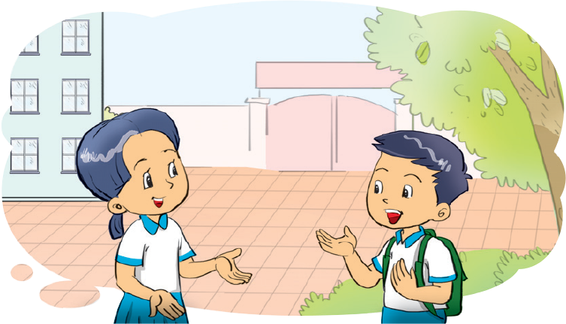
2. Point and say
Hello. I'm _____.
Hello. I'm _________.
Mai
Miss Hien
1
2
Hello _________. I'm __________.
Hello _______. I'm _______.
Miss Hien
Mai
Nam
Quan

Slide 9
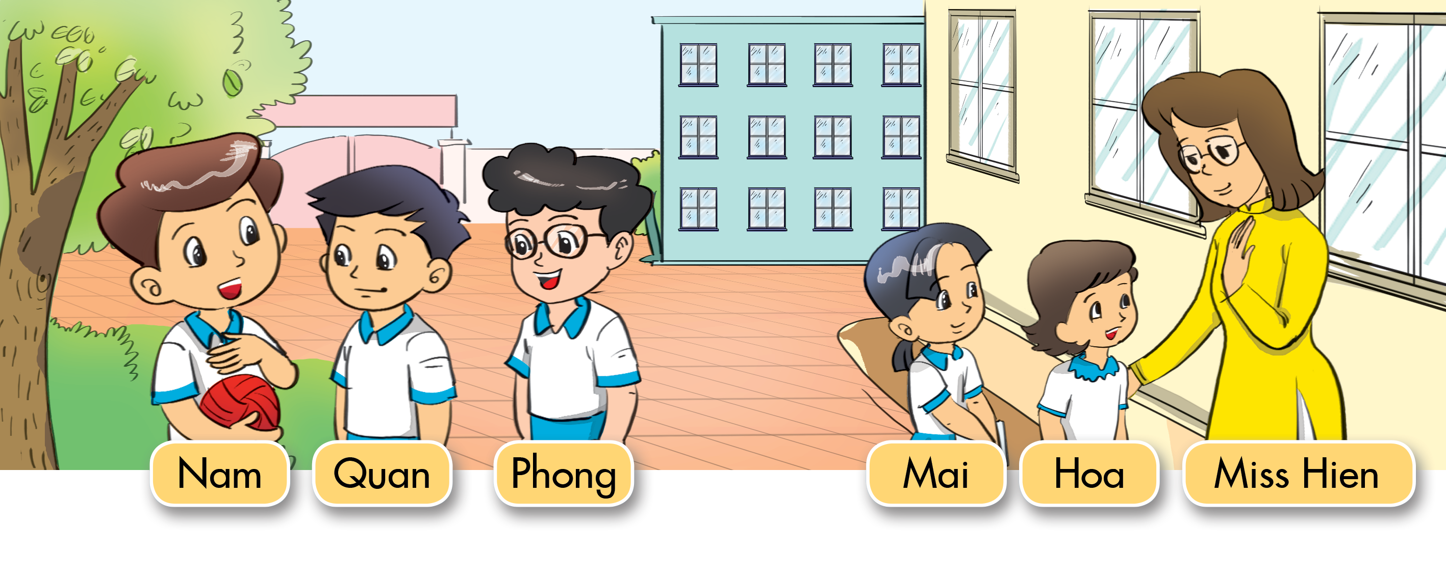
3. Let’s talk
Nam
Hello, I'm _______.
Hello, I'm _________.
Miss Hien
Hello, I'm ______.
Quan
Hoa
Hello, I'm _____.
Hello, I'm ______.
Phong
Hello, I'm ______.
Mai

Slide 10
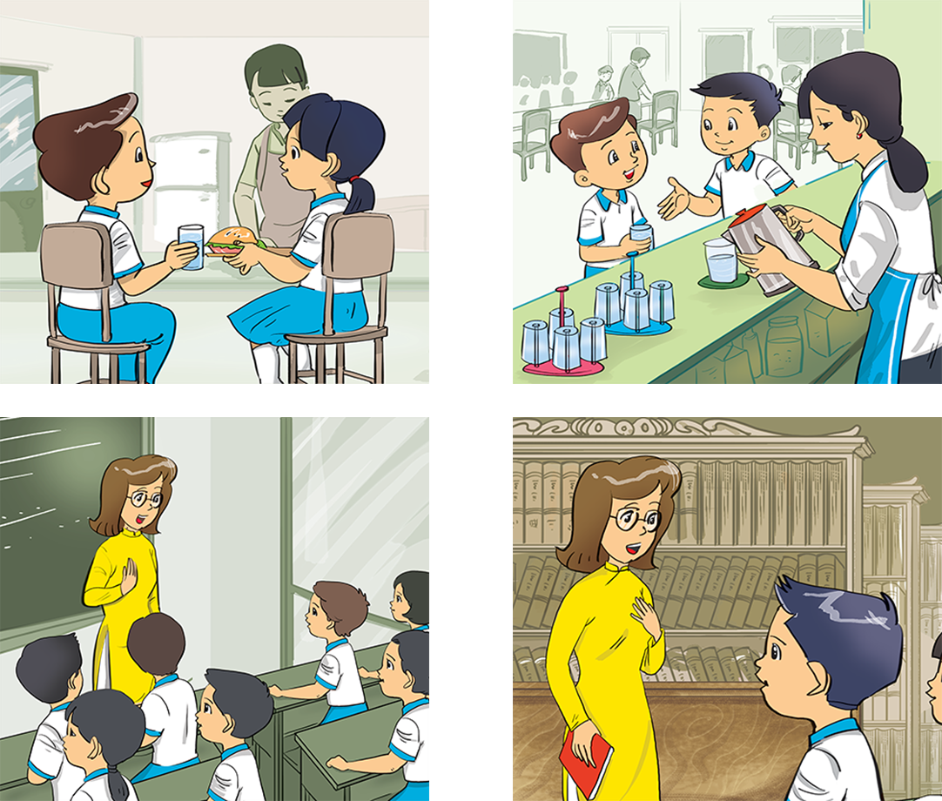
4. Listen and tick.
a
b
1
a
b
2

Slide 11
5. Let's write.
I'm
Hello
Mai: _______. I'm Mai.
Nam: Hi, Mai. _______ Nam.
Miss Hien: Hello. _______ Miss Hien.
Class: _______, Miss Hien. Nice to meet you.
Hello
1
I'm
I'm
2
Hello

Slide 12
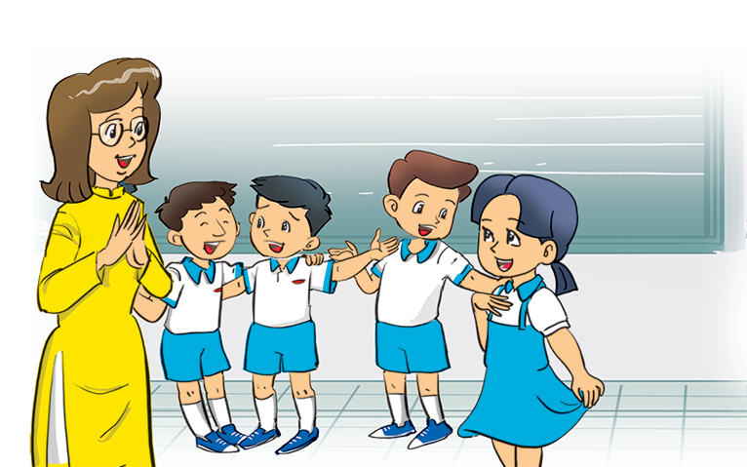
6. Let's sing.

Slide 13
Thank you!

