Slide 1
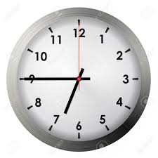
A: What time is it?
B: It’s three o’clock.
It’s six forty-five.

Slide 2
Thursday,
20th
January,
2022.
Unit 11: What time is it?
Lesson 2

Slide 3


Slide 4

six o’clock.
have breakfast
have dinner
go to bed

Slide 8

Thursday, 20th January, 2022.
Unit 11: What time is it?
Lesson 2
*A: What time do you get up?
have breakfast?
have dinner?
go to bed?
B: I get up at six o’clock.

