Slide 1
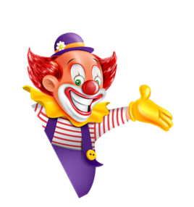

I always get up early.
How about you?
Unit
02
Lesson 3

Slide 2


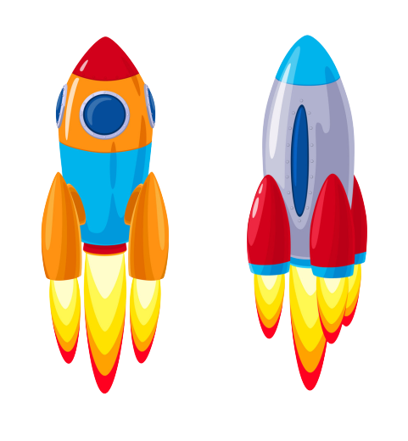
Next
ĐUA TÊN LỬA
Start
Notes:
Ms Huyền Phạm - 0936.082.789 – YOUTUBE: MsPham. Facebook: Dạy và học cùng công nghệ.

Slide 3








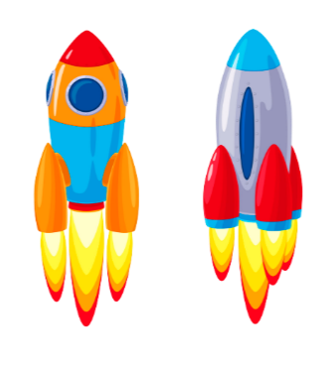
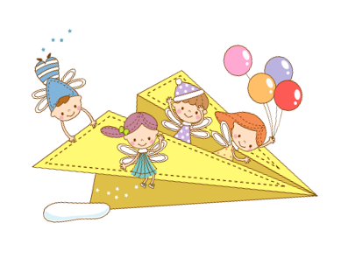
Next
Thử thách
QUYẾT ĐỊNH
Notes:
Ms Huyền Phạm - 0936.082.789 – YOUTUBE: MsPham. Facebook: Dạy và học cùng công nghệ.

Slide 4
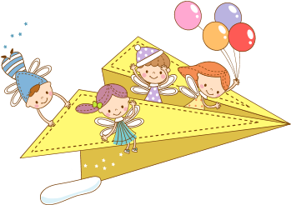
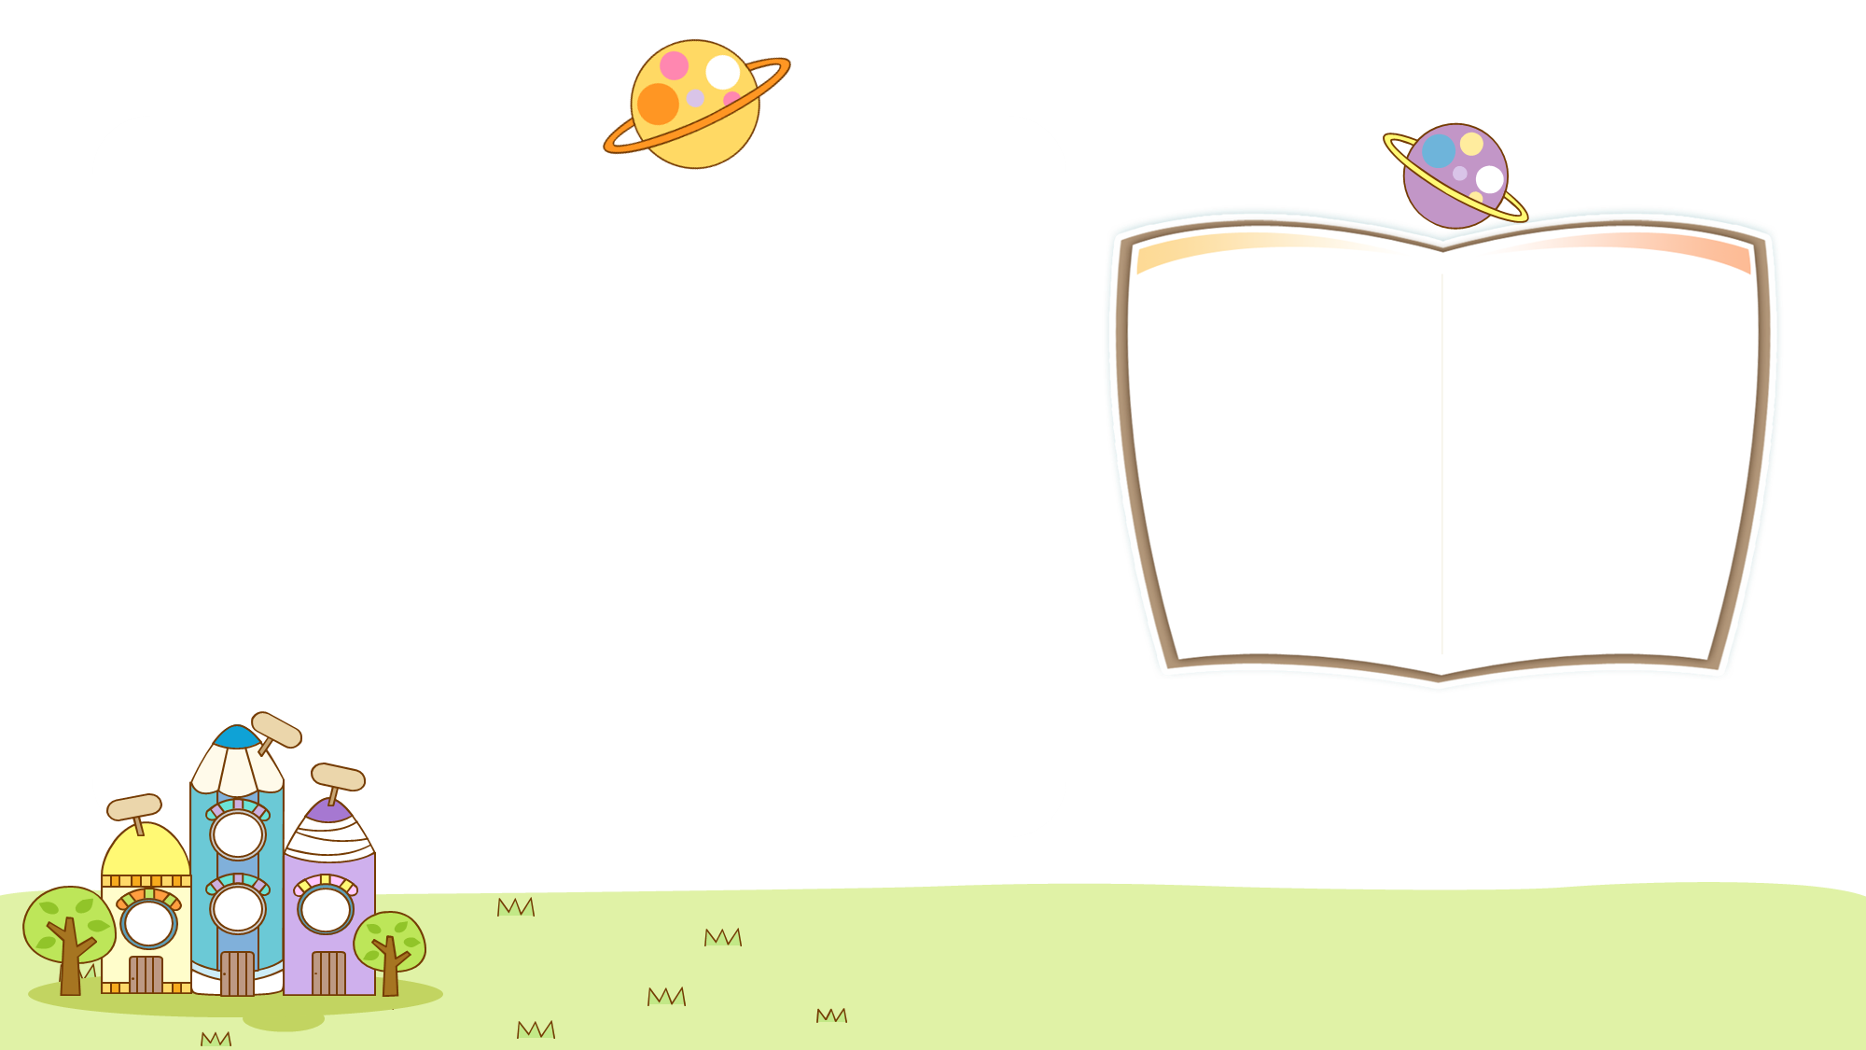

Back
_______ do you do in the morning?
What
Xem đáp án
Notes:
Ms Huyền Phạm - 0936.082.789 – YOUTUBE: MsPham. Facebook: Dạy và học cùng công nghệ.

Slide 5
Back
What____you do in the afternoon?
do
Xem đáp án
Notes:
Ms Huyền Phạm - 0936.082.789 – YOUTUBE: MsPham. Facebook: Dạy và học cùng công nghệ.

Slide 6
Back
_______ do you visit your grandparents?
How often
Xem đáp án
Notes:
Ms Huyền Phạm - 0936.082.789 – YOUTUBE: MsPham. Facebook: Dạy và học cùng công nghệ.

Slide 7
Back
I usually go to school five _______ a week.
Times/ days
Xem đáp án
Notes:
Ms Huyền Phạm - 0936.082.789 – YOUTUBE: MsPham. Facebook: Dạy và học cùng công nghệ.

Slide 8
Back
I do morning exercise _____ day.
Every
Xem đáp án
Notes:
Ms Huyền Phạm - 0936.082.789 – YOUTUBE: MsPham. Facebook: Dạy và học cùng công nghệ.

Slide 9
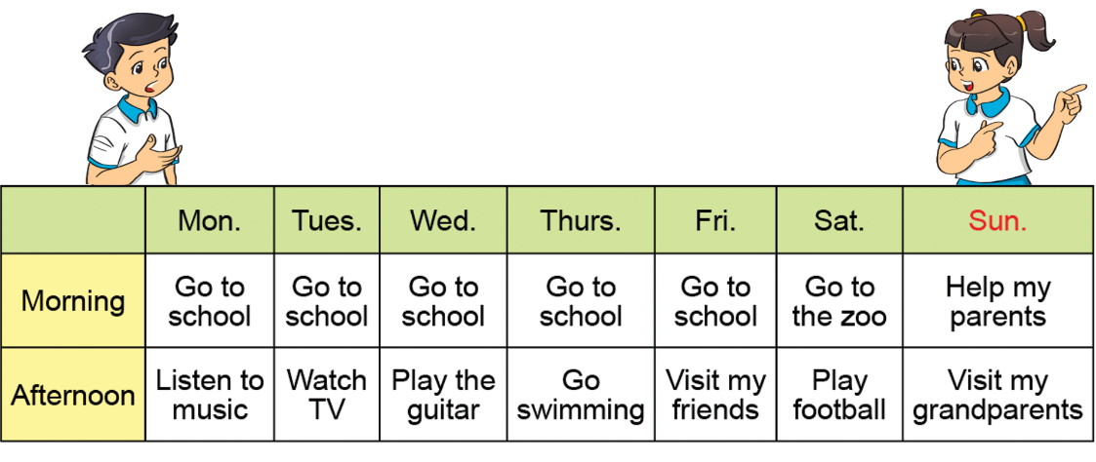
Back
One a week
I go swimming __________.
Xem đáp án
Notes:
Ms Huyền Phạm - 0936.082.789 – YOUTUBE: MsPham. Facebook: Dạy và học cùng công nghệ.

Slide 10
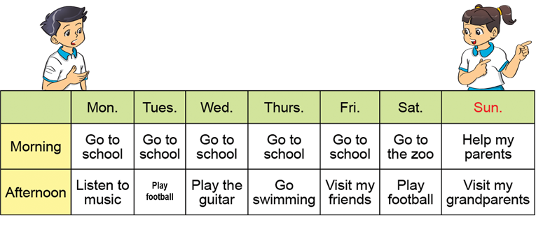
Back
Twice a week
I play fooball _________.
Xem đáp án
Notes:
Ms Huyền Phạm - 0936.082.789 – YOUTUBE: MsPham. Facebook: Dạy và học cùng công nghệ.

Slide 11
Prounciation

Slide 12
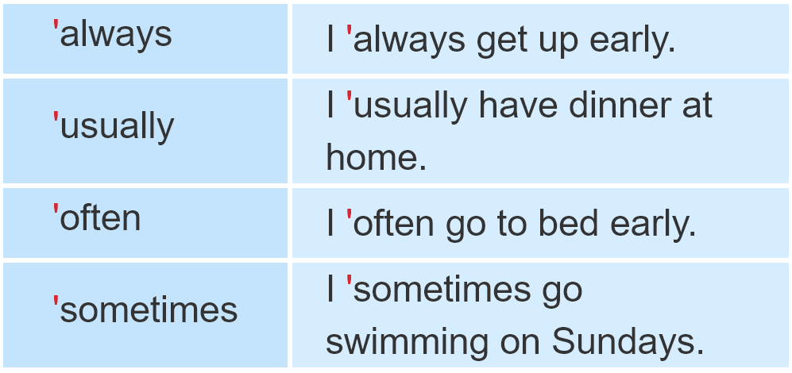

1. Listen and repeat

Slide 13
2. Listen and circle a or b. Then say the sentences aloud.
1. I___________ go to bed early.
a. always b. sometimes
2. He ___________ plays football after school.
a. sometimes b. often
3. She ___________ goes shopping on Sundays.
a. usually b. always
4. We___________ go camping at the weekend.
a. often b. sometimes

Slide 14
Practise

Slide 15

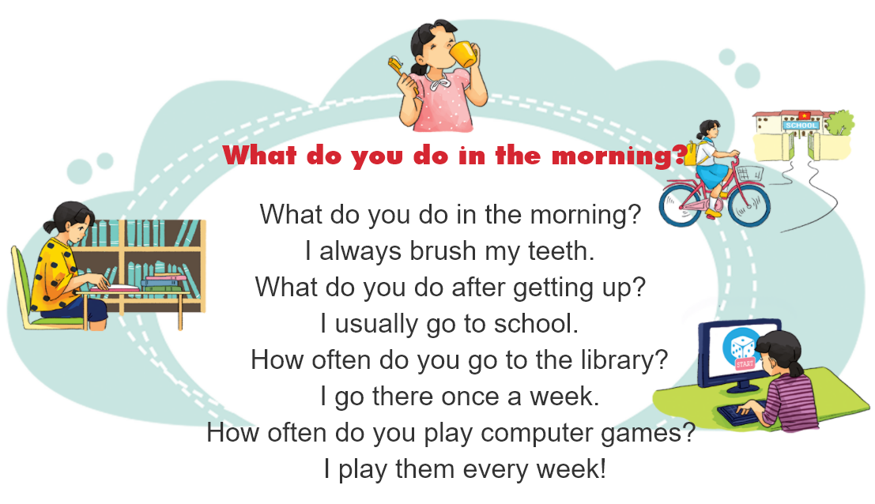
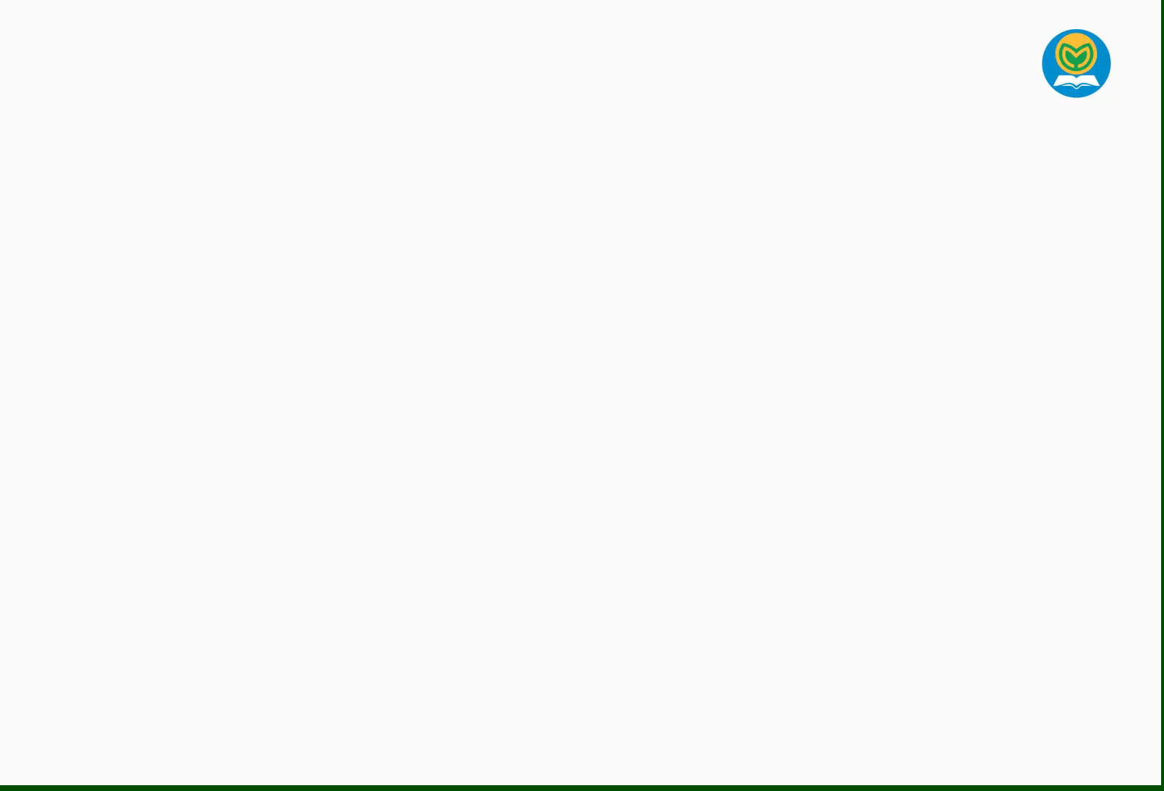
3. Let’s chant.

Slide 16
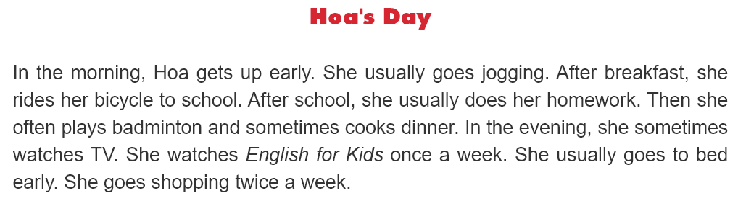
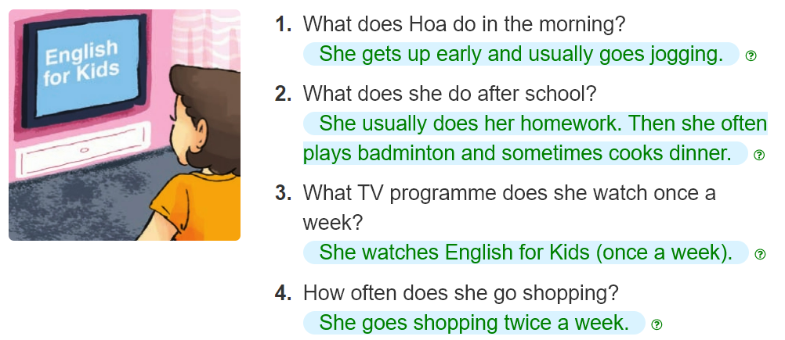
4. Read and answer.
______________________________________.
________________________________________.
______________________________________.
______________________________________.

Slide 17
5. Write about your day.
My name is ____________.
In the morning, I always____________.
In the afternoon, I usually ____________.
In the evening, I ____________.
I ____________a week.

Slide 18
6. Project.
Interview two of your classmates about their daily routines.

