Slide 1
Unit 3
Where did you go
on holiday?
Lesson 1

Slide 2
Vocabulary

Slide 3
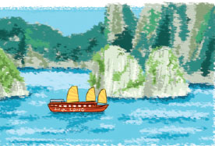

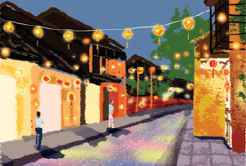
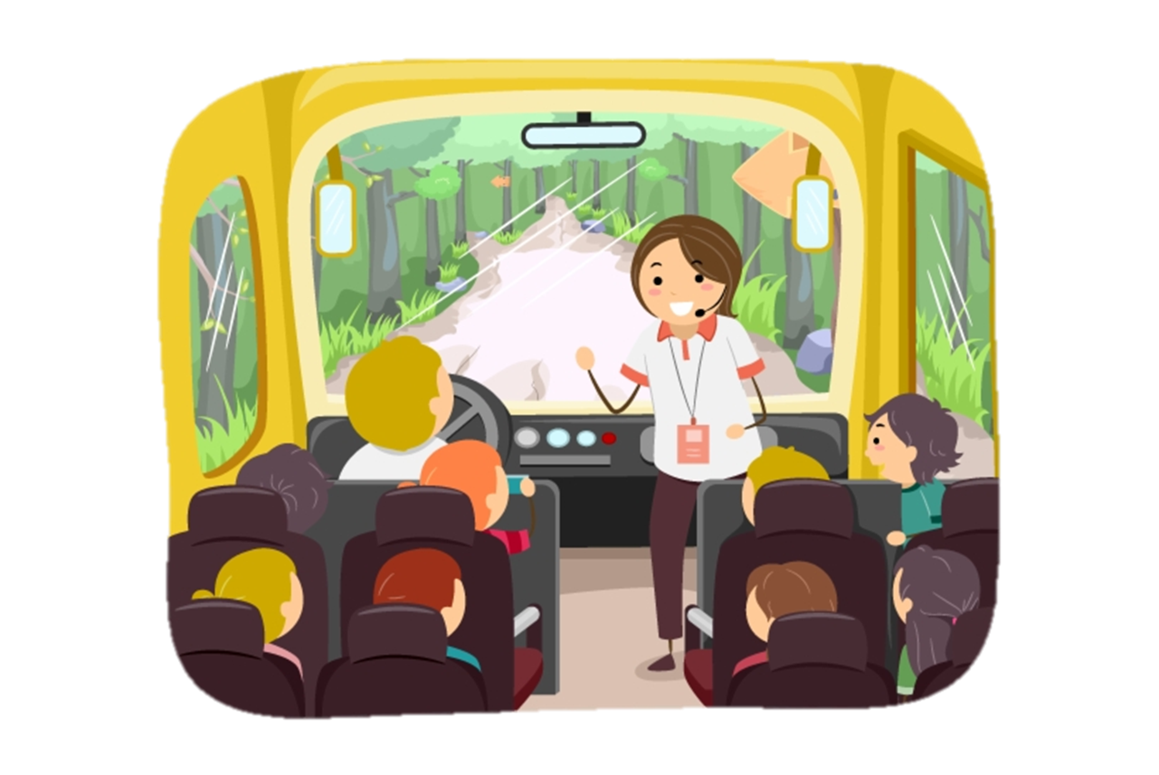


Vocabulary
Ha Long Bay
Phu Quoc Island
Hoi An Ancient Town
Vịnh Hạ Long
Đảo Phu Quốc
Phố cổ Hội An
Hue Imperial City
trip
holiday
Cố đô Huế
Chuyến đi
Kì nghỉ

Slide 4
Look and match
1
2
3
c
a
b
Hoi An
Ancient Town
trip
Phu Quoc Island
d
e
f
Phố cổ Hội An
Đảo Phu Quốc
Chuyến đi

Slide 5
Look and match
1
2
3
a
b
c
holiday
Hue Imperial City
Ha Long Bay
d
e
f
Vịnh Hạ Long
Kì nghỉ
Cố đô Huế

Slide 6
Grammar

Slide 7
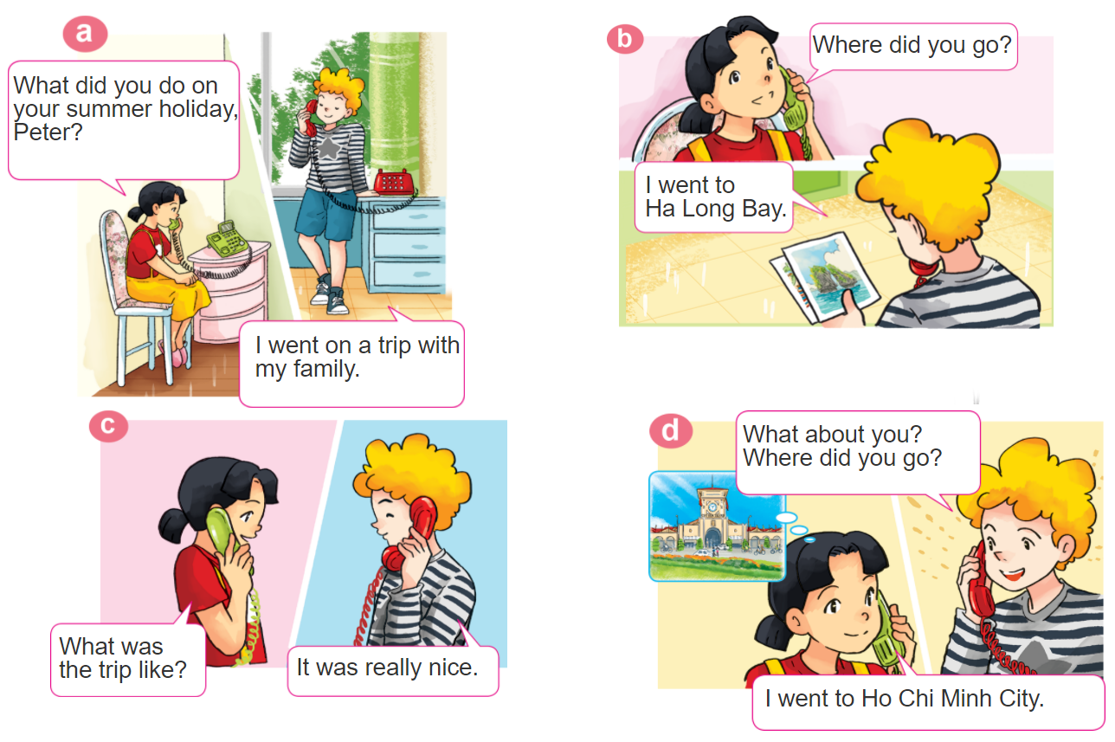

1. Look, listen and repeat

Slide 8


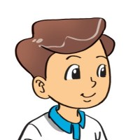

2. Point and say
Where did you go on holiday?
I went to ____________.
Ha Long Bay
Hue
Imperial City
Hoi An
Ancient Town
Phu Quoc Island

Slide 9
Structures
Hỏi và đáp bạn đã đi đâu
Where did you go on holiday?
(Bạn đã đi đâu vào kì nghỉ ?)
I went to ____________.
+ place
Hỏi và đáp bạn đã làm gì
What did you do on holiday?
(Bạn đã làm gìvào kì nghỉ ?)
I ____________.
+ activity

Slide 10
Structures
Hỏi và đáp chuyến đi như thế nào
What was the trip like ?
(___________như thế nào?)
It was ____________.
+ tính từ miêu tả

Slide 11
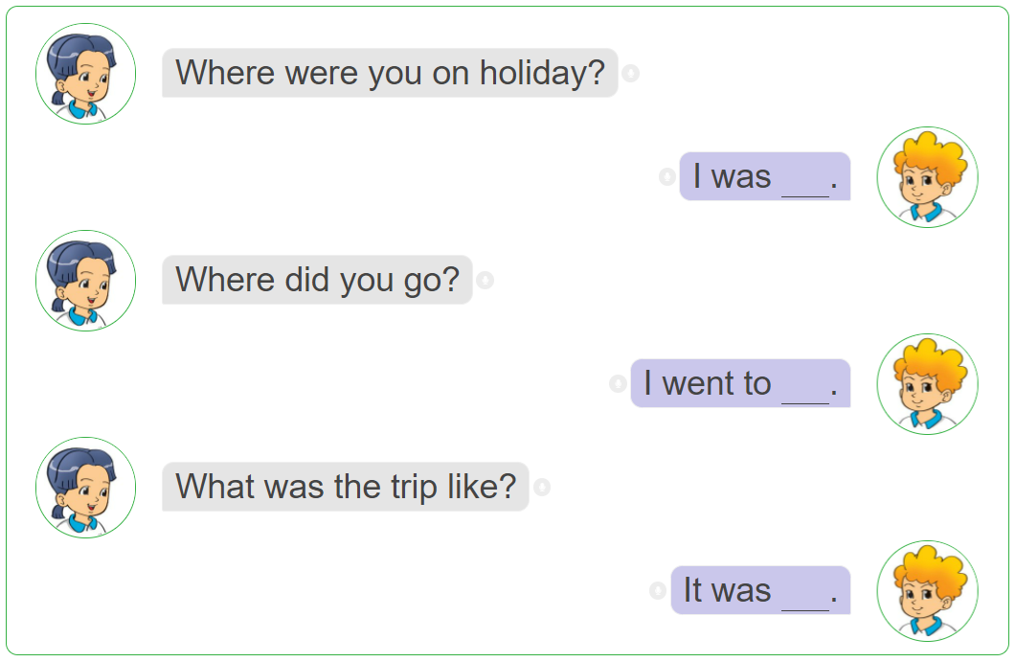
3. Let’s talk.

Slide 12

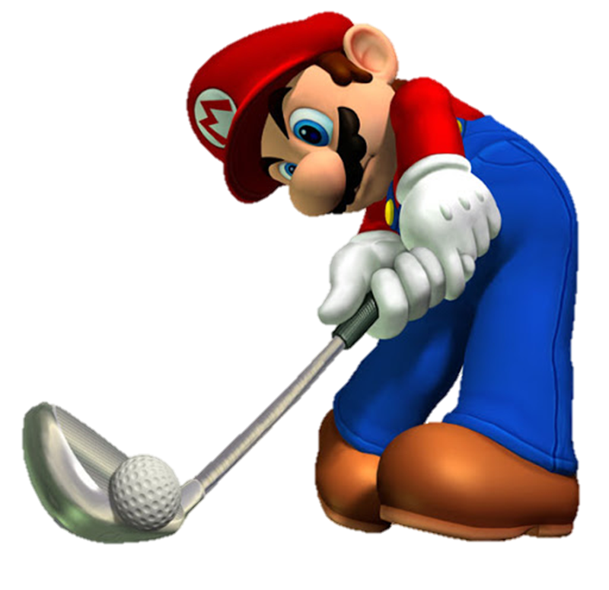
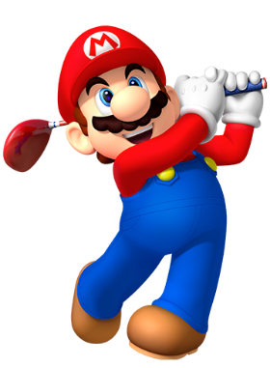




Slide 13






Where did you go on holiday?
I went to school.
I went to Hue Imperial City.
I went to HaNoi.

Slide 14
Where did you go on holiday?
I went to HaNoi.
I went to Ho Chi Minh City.
I went to Hoi An
Ancient Town.

Slide 15
Where did you go on holiday?
I went to HaLong Bay.
I went to Phu Quoc Island.
I went to Hue Imperial city.

Slide 16
Where did you go on holiday?
I went to
Ha Long Bay.
I went to Phu Quoc Island.
I went to Cat Ba Island.

Slide 17
Where did you go on holiday?
I went to Phu Quoc Island.
She went to Phu Quoc Island.
He went to Phu Quoc Island.

Slide 18
Where ____ you go on holiday?
are
do
did

Slide 19
What was the trip like?
It is great.
It was great.
It great.

Slide 20
What was the trip like?
It ______ really happy.
was
is
like

Slide 21
What was the trip _____?
It was really nice.
are
do
like

Slide 22



Slide 23
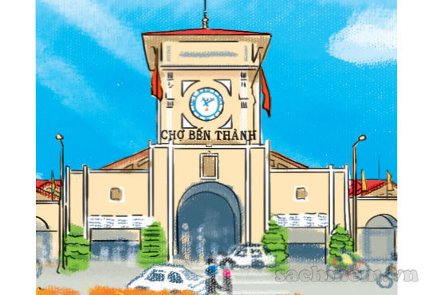
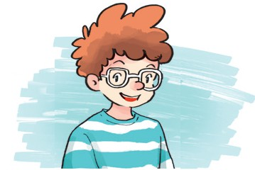
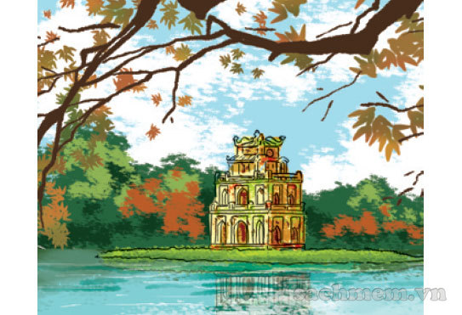
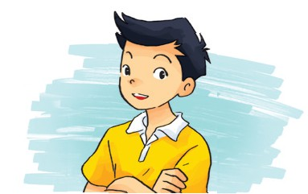
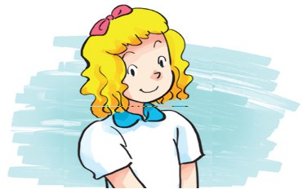


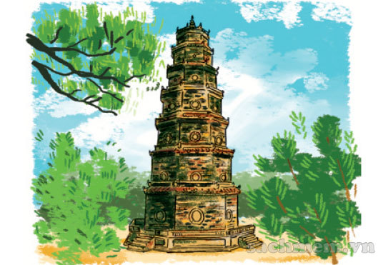
4. Listen and match
a
1
b
2
3
c
4
d

Slide 24









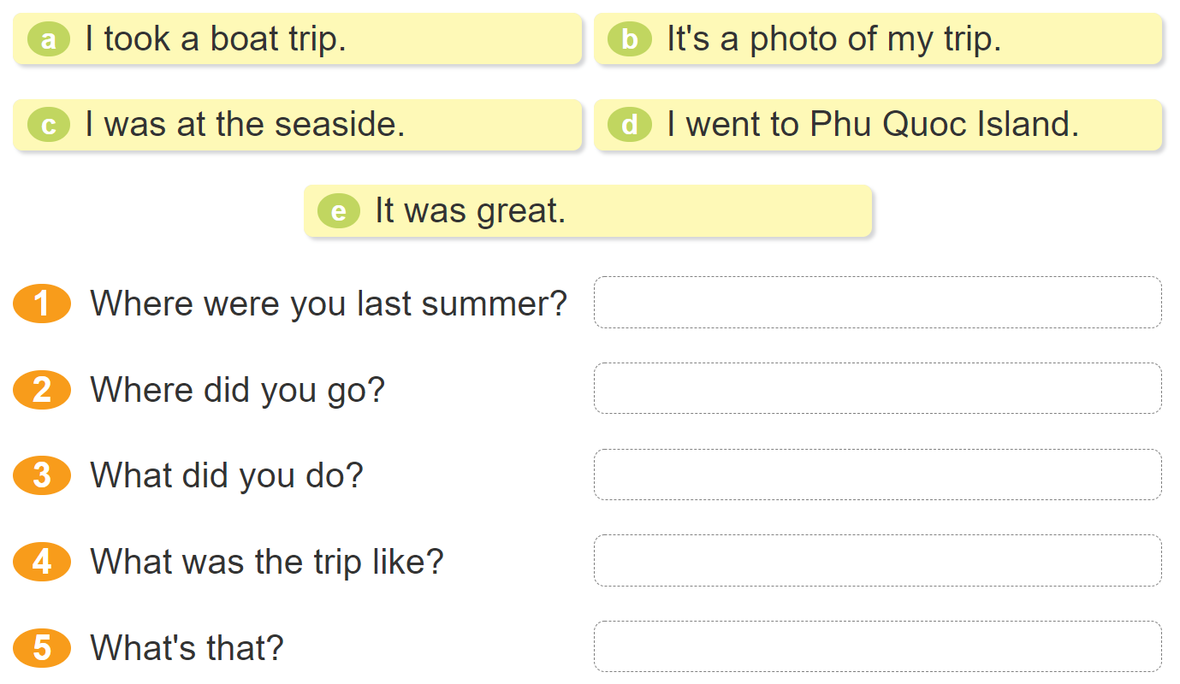






5. Read and match.

Slide 25
6. Let’s play.

