Slide 1
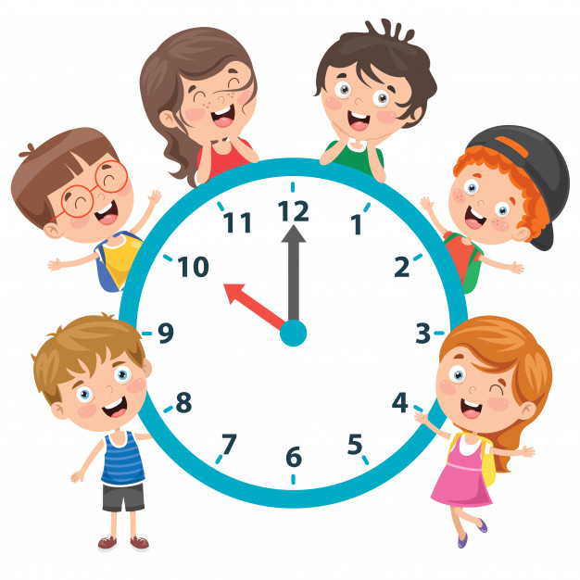
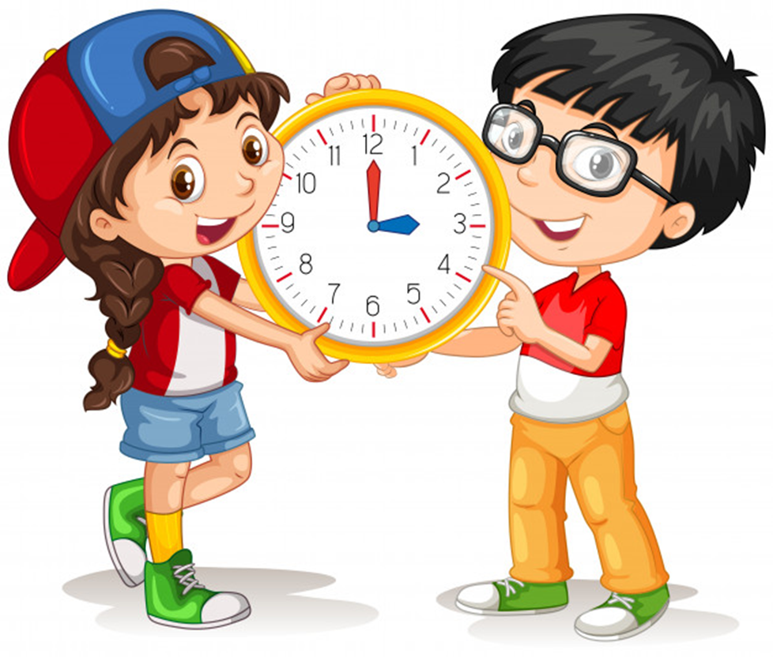
Unit 11
What time is it?
Lesson 2

Slide 2
WARM-UP

Slide 3
Look and say
1. 5.00 | five o'clock
2. 5.05 | five five
3. 5.15 | five fifteen
4. 5.25 | five twenty-five
5. 5.30 | five thirty
6. 5.35 | five thirty-five
7. 5.45 | five forty-five
8. 5.50 | five fifty

Slide 4
Vocabulary

Slide 5
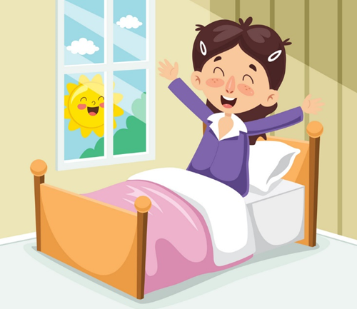

Get up

Slide 6
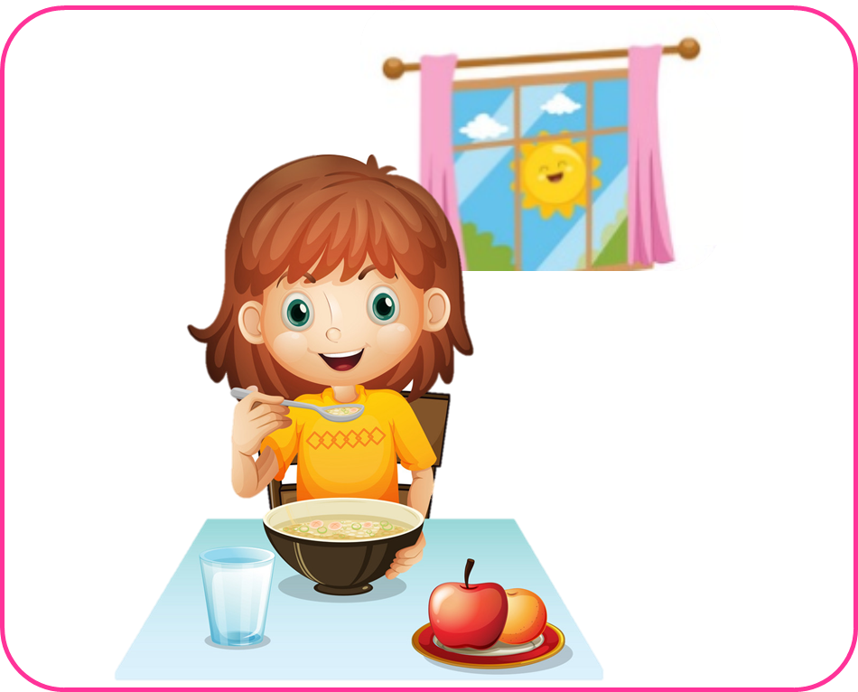
Have breakfast

Slide 7
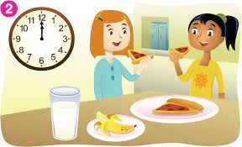
Have lunch

Slide 8

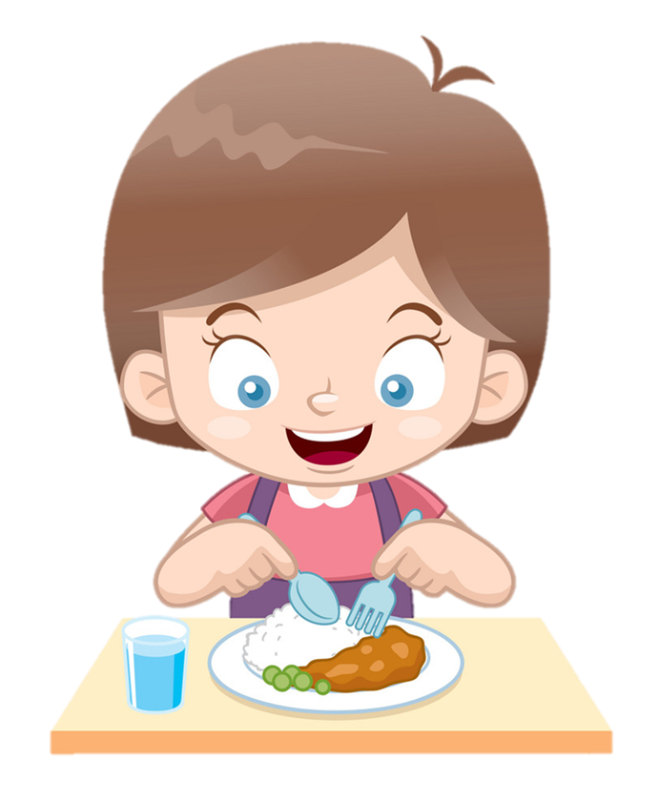
Have dinner

Slide 9

Go to school

Slide 10
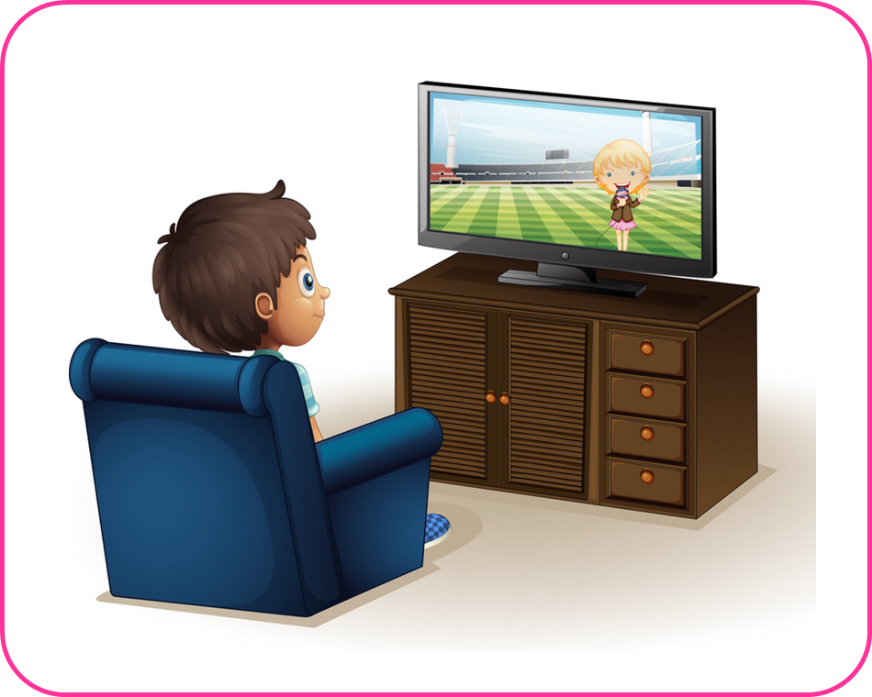
Watch TV

Slide 11
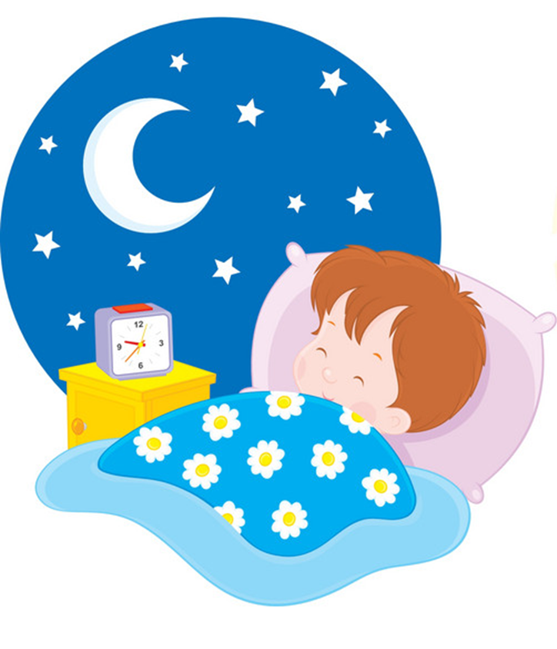
Go to bed

Slide 12
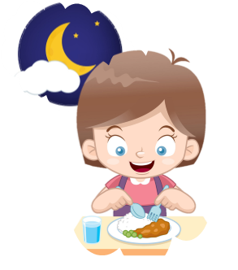
Review
Get up
Have breakfast
Have lunch
Have dinner
Go to bed

Slide 13

Read and tick
2
✔
3
1
Have breakfast

Slide 14
Read and tick
1
✔
3
2
Go to bed

Slide 15
Read and tick
3
✔
1
2
Have dinner

Slide 16
Read and tick
✔
2
3
1
Go to school

Slide 17
Read and tick
1
2
3
✔
Get up

Slide 18
GRAMMAR

Slide 19
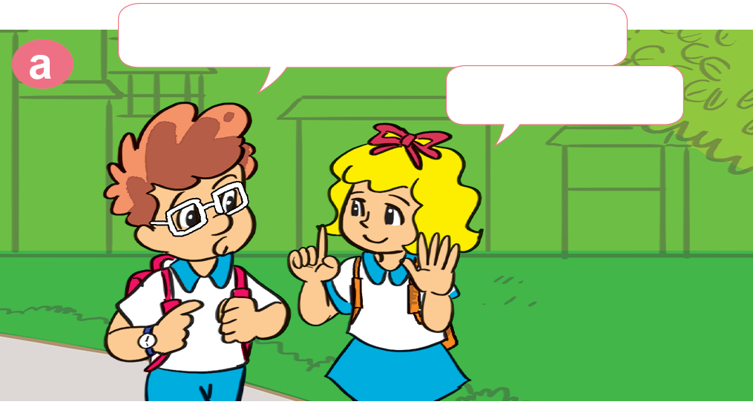
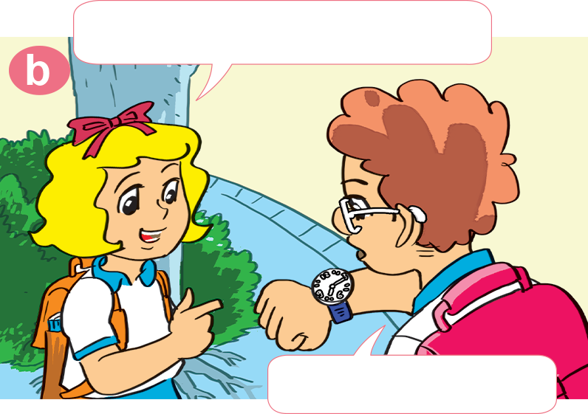

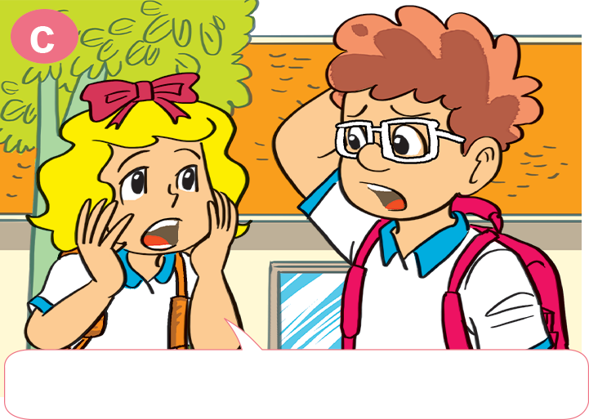
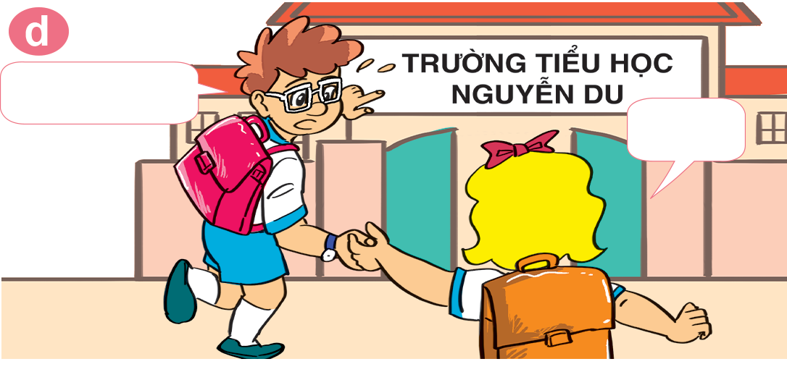
1. Look, listen and repeat.
What time do you get up?
What time is it now?
Six o'clock.
Seven fifteen.
Let's run.
Yes!
Oh no! We're late for school.

Slide 20
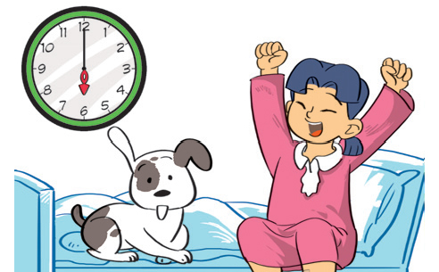

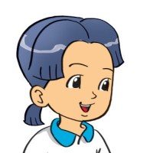
2. Point and say.
get up
What time do you _____________?
get up
six o’clock
I __________ at ____________.

Slide 21
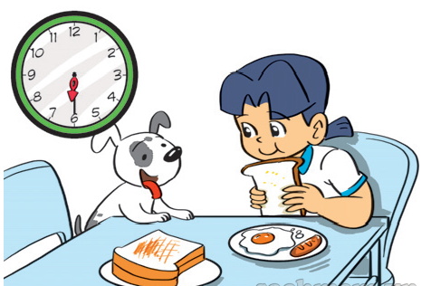
2. Point and say.
What time do you ________________?
have breakfast
I _______________ at ____________.
have breakfast
six thirty

Slide 22
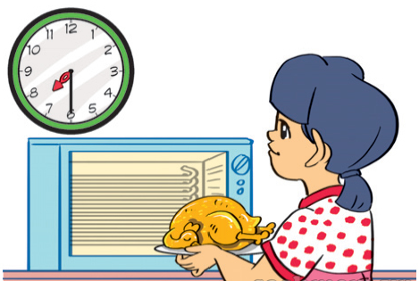
2. Point and say.
have dinner
What time do you _____________?
have dinner
I _____________ at ____________.
seven thirty

Slide 23
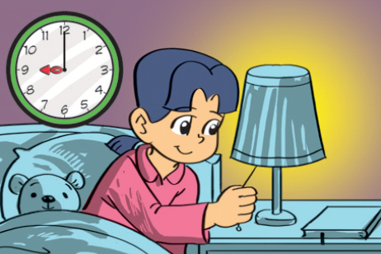
2. Point and say.
go to bed
What time do you _____________?
go to bed
I ____________ at ____________.
nine o’clock

Slide 24

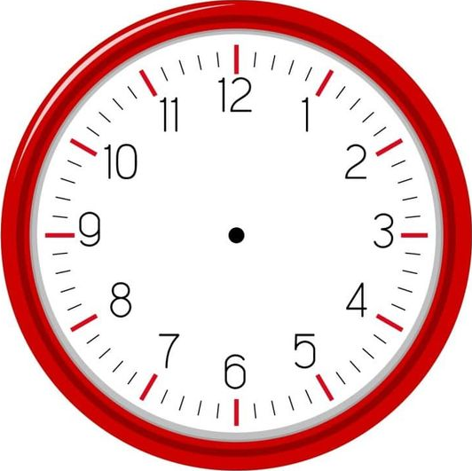


3. Let’s talk
What time do you _____?
I _______ at + (giờ).
Go to bed
Get up
Watch TV
Have breakfast
Have dinner
Go to school

Slide 25
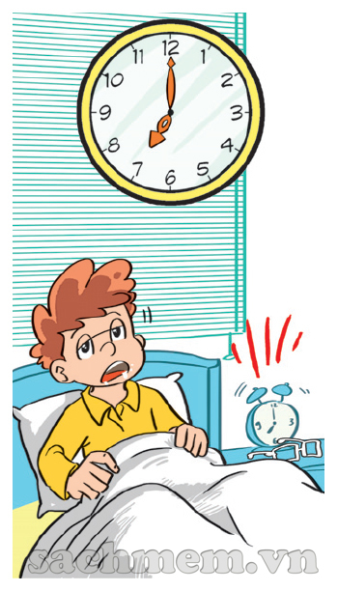
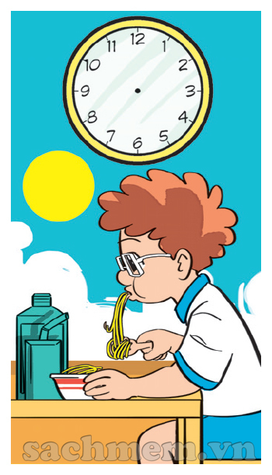

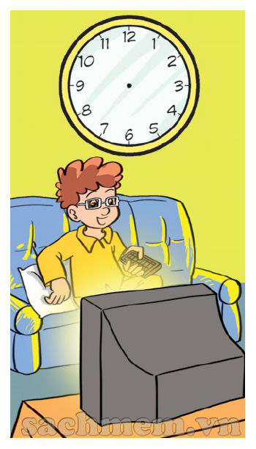
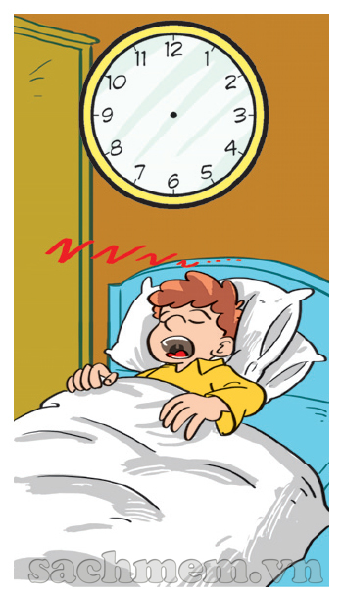
3. Listen draw the time.
1
2
3
4
5
7:00
7:30
8:15
8:00
9:00

Slide 26
Model sentence
What time do you _____?
I _______ at + (giờ).
Go to bed
Get up
Watch TV
Have breakfast
Have dinner
Go to school

Slide 27
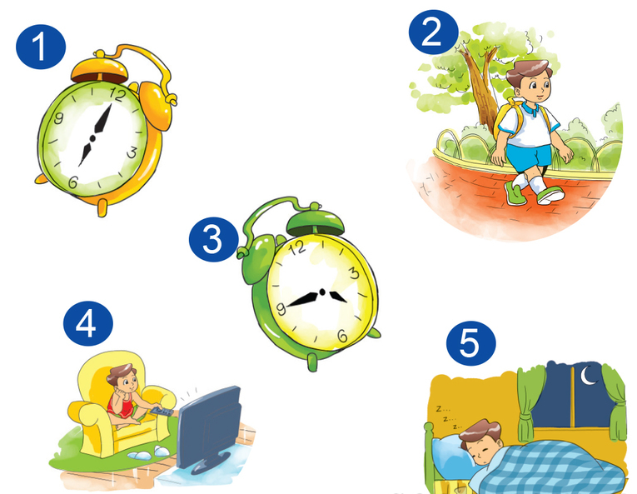
5. Read and write
Hello. My name is Nam. I study at Nguyen Du Primary School. Every day I get up at (1) __________. I (2) __________ at seven fifteen. School starts at
six o'clock
go to school
seven thirty in the morning and finishes at four thirty in the afternoon. I go home at (3) ____________. After dinner, I (4) ________ or listen to music. I (5) __________ at nine forty-five.
four forty-five
watch TV
go to bed

Slide 28
Extra sentence
What time does he/she _____?
He/she _______ at + (giờ).
Goes to bed
Gets up
Watches TV
Has breakfast
Has dinner
Goes to school

Slide 29





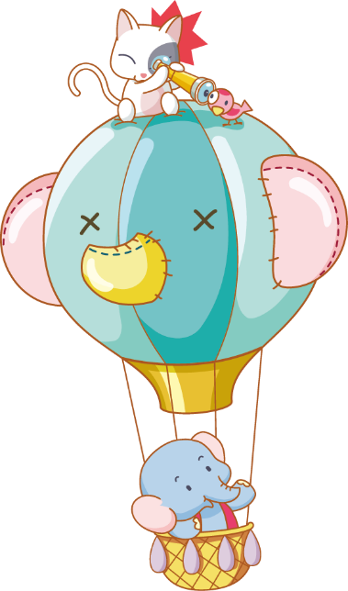




Luật chơi:
Chia lớp thành các đội
Bấm nút để quay, màu để dừng
Trả lời đúng được cộng điểm, nhường quyền trả lời cho đội bạn.
Kết thúc trò chơi đội nhiều điểm hơn giành chiến thắng.
PLAY
Notes:
Ms Huyền Phạm - 0936.082.789 – YOUTUBE: MsPham. Facebook: Dạy và học cùng công nghệ.

Slide 30

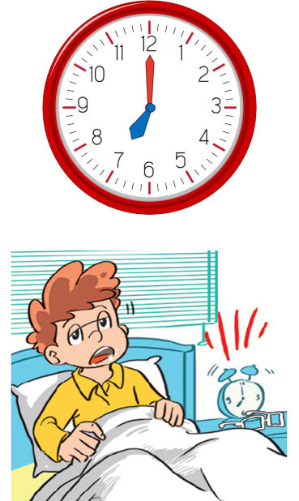


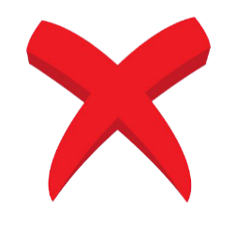
27
What time does he get up?
20
He gets up at seven o’clock.
She gets up at seven o’clock.
A.
B.
QUESTION
I get up at seven o’clock.
He get up at seven o’clock.
C.
D.
Notes:
Ms Huyền Phạm - 0936.082.789 – YOUTUBE: MsPham. Facebook: Dạy và học cùng công nghệ.

Slide 31

What time does he go to school?
10
He go to school at eight fifteen.
He goes to school at eight fifteen.
A.
B.
QUESTION
C.
She goes to school at eight fifteen.
D.
He goes to school at eight fifteen o’clock.
Notes:
Ms Huyền Phạm - 0936.082.789 – YOUTUBE: MsPham. Facebook: Dạy và học cùng công nghệ.

Slide 32
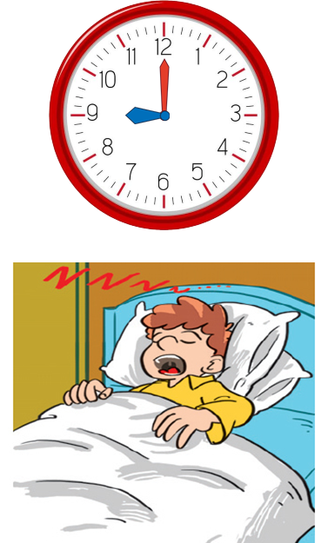
What time do you go to bed?
10
I goes to bed at nine o’clock.
He goes to bed at nine o’clock.
A.
B.
QUESTION
She goes to bed at nine o’clock.
I go to bed at nine o’clock.
C.
D.
Notes:
Ms Huyền Phạm - 0936.082.789 – YOUTUBE: MsPham. Facebook: Dạy và học cùng công nghệ.

Slide 33
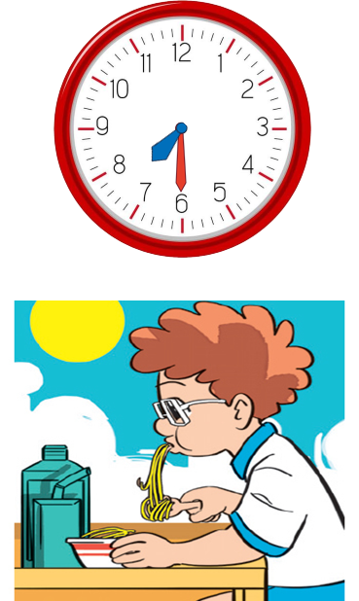
What time ___ you have breakfast?
20
does
is
A.
B.
QUESTION
do
are
C.
D.
Notes:
Ms Huyền Phạm - 0936.082.789 – YOUTUBE: MsPham. Facebook: Dạy và học cùng công nghệ.

Slide 34

What time ___ she have go to school?
10
do
are
A.
B.
QUESTION
does
is
C.
D.
Notes:
Ms Huyền Phạm - 0936.082.789 – YOUTUBE: MsPham. Facebook: Dạy và học cùng công nghệ.

Slide 35
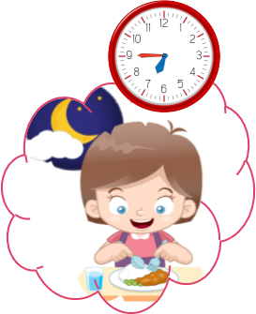
What time does she _________ ?
20
Has dinner
Have dinner
A.
B.
QUESTION
Have breakfast
Has breakfast
C.
D.
Notes:
Ms Huyền Phạm - 0936.082.789 – YOUTUBE: MsPham. Facebook: Dạy và học cùng công nghệ.

Slide 36
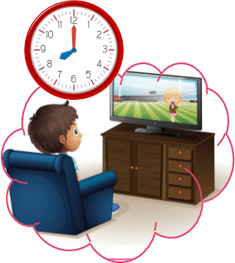
_____ watchesTv at eight o’clock.
20
He
She
A.
B.
QUESTION
I
What time
C.
D.
Notes:
Ms Huyền Phạm - 0936.082.789 – YOUTUBE: MsPham. Facebook: Dạy và học cùng công nghệ.

Slide 37
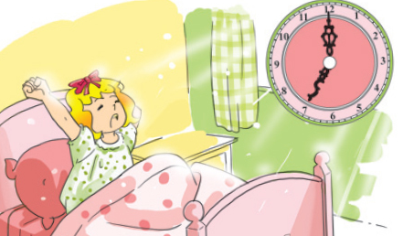
Linda _____at seven o'clock.
20
gets up
goes to bed
A.
B.
QUESTION
get up
oo to bed
C.
D.
Notes:
Ms Huyền Phạm - 0936.082.789 – YOUTUBE: MsPham. Facebook: Dạy và học cùng công nghệ.

Slide 38
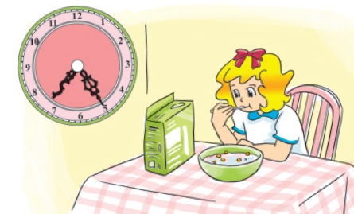
She ______ at seven twenty-five
10
Have breakfast
Watch TV
A.
B.
QUESTION
Has breakfast
Watches TV
C.
D.
Notes:
Ms Huyền Phạm - 0936.082.789 – YOUTUBE: MsPham. Facebook: Dạy và học cùng công nghệ.

Slide 39
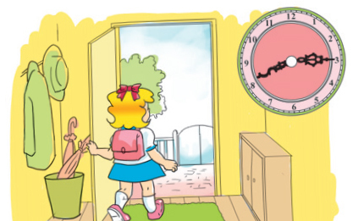
______ goes to school at eight fifteen
20
He
What time
A.
B.
QUESTION
She
You
C.
D.
Notes:
Ms Huyền Phạm - 0936.082.789 – YOUTUBE: MsPham. Facebook: Dạy và học cùng công nghệ.

Slide 40
At ten o’clock.
100
What time does she go to bed.
What time does she goes to bed.
A.
B.
QUESTION
What does she go to bed.
What time do she go to bed.
C.
D.
Notes:
Ms Huyền Phạm - 0936.082.789 – YOUTUBE: MsPham. Facebook: Dạy và học cùng công nghệ.

Slide 41
What time do you get up?
20
On six thirty
At six thirty
A.
B.
QUESTION
At six thirty o’clock
In six thirty
C.
D.
Notes:
Ms Huyền Phạm - 0936.082.789 – YOUTUBE: MsPham. Facebook: Dạy và học cùng công nghệ.

Slide 42

Notes:
Ms Huyền Phạm - 0936.082.789 – YOUTUBE: MsPham. Facebook: Dạy và học cùng công nghệ.

Slide 43
Thank you!

Slide 44

Match
Watch TV
4
1
Go to bed
Have breakfast
2
5
Have dinner
Get up
3
6
Go to school

Slide 45
Read and tick
2
3
✔
1
6
4
5
Watch TV

